Slide 1
PSIRF: Changing culture
RCP: Medical care – driving change, Tues 27 June 2023

Slide 2
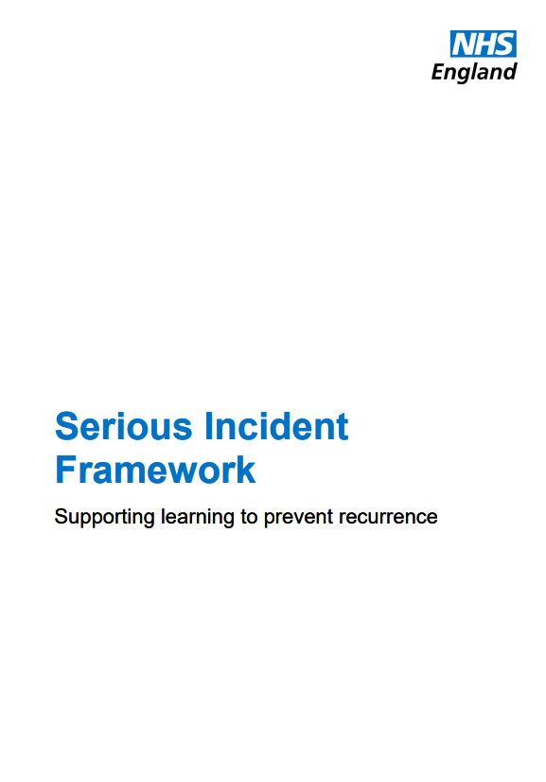
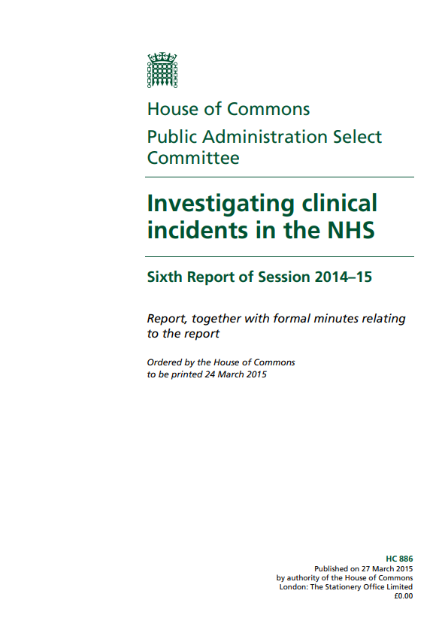
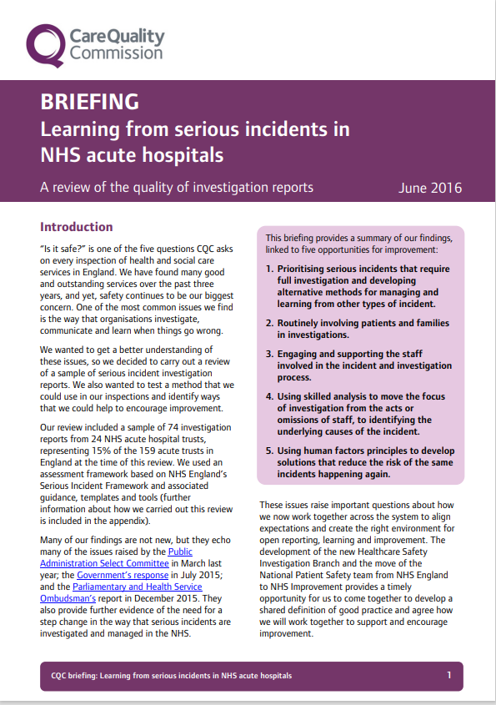
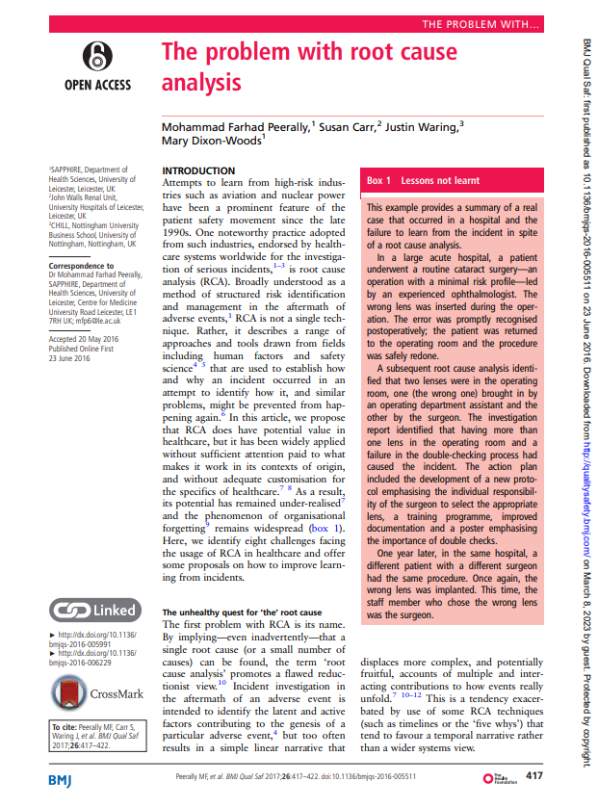
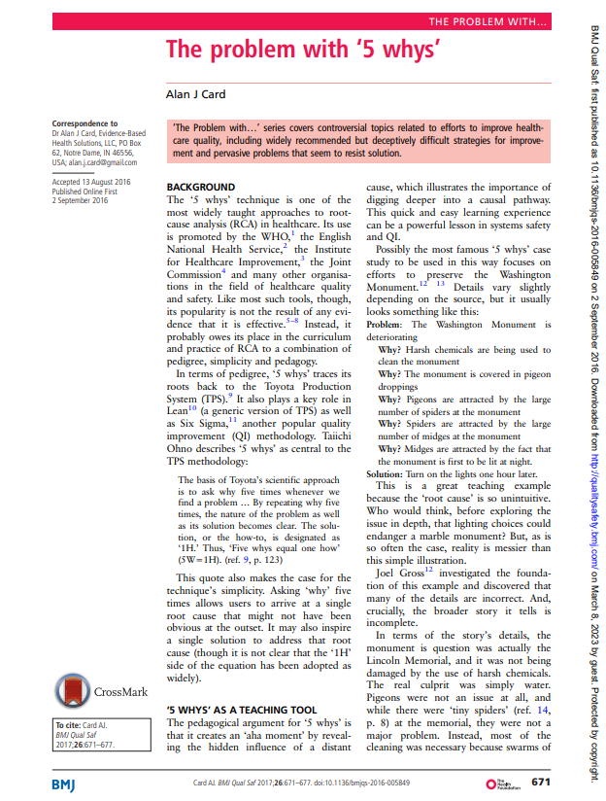
Policy context
“Despite pockets of best practice, good intentions and strong leadership, clinical incident investigation and complaints handling fall far short of what patients, their families, clinicians and NHS staff are entitled to expect”
“We found that 40% of investigations were not adequate to find out what happened. Not only are trusts not identifying failings, they are also not finding out why the failings happened in the first place”
“The Framework aims to facilitate learning by promoting a fair, open, and just culture that abandons blame as a tool and promotes the belief that ‘incidents cannot simply be linked to the actions of the individual healthcare staff involved but rather the system in which the individuals were working’”
“…in the absence of other agreed and potentially more proportionate responses, trusts often see the formal investigation process as the only available option for learning from incidents resulting in harm”

Slide 3
Serious incident processes can feel punitive, can stifle our potential to learn and improve and can limit our ability to put the needs of people including staff, patients and families first.

Slide 4
Introducing PSIRF
Sets out a new approach to achieving effective learning and improvement following patient safety incidents
Embeds patient safety incident response within a wider system of improvement
Supports a significant shift in safety culture
Prompts a move away from a reactive and bureaucratic approach to safety towards systematic safety management
Testing and revision has been a formal part of the development cycle
NHS England » Patient Safety Incident Response Framework

Slide 5
Changes to safety management practice
PSIRF does not affect Duty of Candour
Distinction: engagement and involvement
Includes both families and staff affected
RCA no longer recommended
Window on the system
Try out different approaches
Planning
Stakeholder involvement
Emphasis on collaboration
Decisions made together
Non-hierarchical

Slide 6
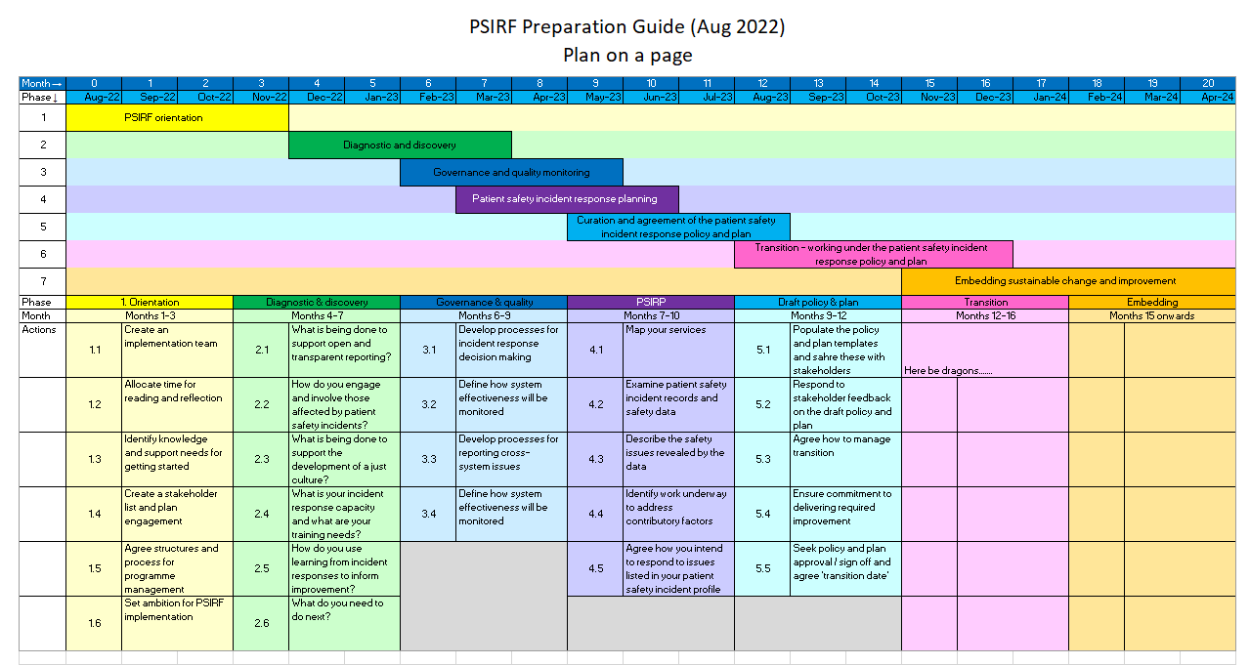
PSIRF requires teams to adapt and implement new ways of working
There is a need for relationship building and undoing entrenched habits
With thanks to: Wendy Halliburton, North Tees and Hartlepool NHS Foundation Trust

Slide 7
Transitioning to PSIRF isn’t easy… but
It feels scary to question something as important as our existing processes for managing patient safety
It requires time and effort to understand and implement a new way of working
It feels a bit uncertain not conducting an RCA for every safety event
Notes:
It is a positive and exciting change, but nonetheless a change
Having to unlearn many years of SI Framework

Slide 8
Transitioning to PSIRF isn’t easy… but
It feels scary to question something as important as our existing processes for managing patient safety
It requires time and effort to understand and implement a new way of working
It feels a bit uncertain not conducting an RCA for every safety event
Organisations will learn more accurately about how work is done and use this to inform improvement
Notes:
It is a positive and exciting change, but nonetheless a change
Having to unlearn many years of SI Framework

Slide 9
Transitioning to PSIRF isn’t easy… but
It feels scary to question something as important as our existing processes for managing patient safety
It requires time and effort to understand and implement a new way of working
It feels a bit uncertain not conducting an RCA for every safety event
Organisations will learn more accurately about how work is done and use this to inform improvement
Improvement will become the focus rather than bureaucracy
Notes:
It is a positive and exciting change, but nonetheless a change
Having to unlearn many years of SI Framework

Slide 10
Transitioning to PSIRF isn’t easy… but
It feels scary to question something as important as our existing processes for managing patient safety
It requires time and effort to understand and implement a new way of working
It feels a bit uncertain not conducting an RCA for every safety event
Organisations will learn more accurately about how work is done and use this to inform improvement
Improvement will become the focus rather than bureaucracy
Ownership and engagement will improve
Notes:
It is a positive and exciting change, but nonetheless a change
Having to unlearn many years of SI Framework

Slide 11
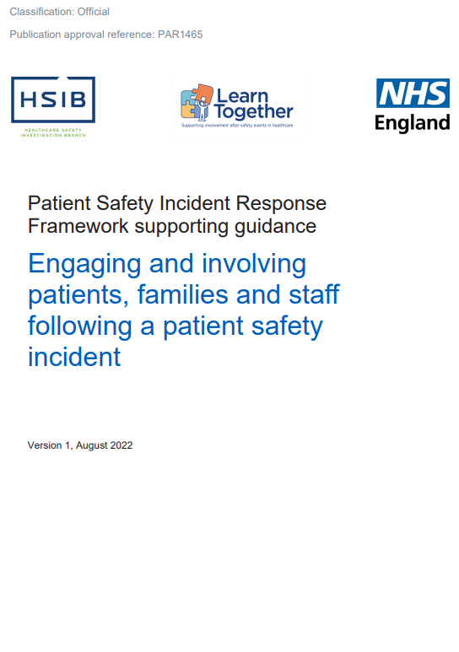
What does PSIRF mean for staff?
New guidance on engaging with staff affected by patient safety events and involving staff throughout any learning response process – your contribution is key!
Learning responses explore system design and how this can be improved – but learning is more than using the tools. Curiosity, trust and psychological safety are key. Statements are no longer required
Staff should continue to record patient safety events via your Local Risk Management System; this enables your organisation to collect important insight to inform allocation of learning and improvement resource.
B1465-2.-Engaging-and-involving...-v1-FINAL.pdf (england.nhs.uk)

Slide 12
What changes have we seen?
“I’ve seen a real difference when we go speak to staff, rather than asking for a statement people initially look quite nervous, they think it must be terrible if someone wants to speak to them, but as we explain, actually we just want to understand what it’s like to be you, doing your job day in and day out accepting you came to work to do a good job. So what was the context of this incident and what could we learn and you can see them visibly relax and people express how good it is to be involved”
“I have found… [that] we capture… patient and front-line staff experience right at the centre of our incident. When sometimes it was the organisation’s priority that was right at the heart of it and I think that’s a real difference”
“We found an after action review… get[s] the staff involved so they don’t feel blamed… so we can apply just culture in a really positive way and the staff will come up with the recommendations and the actions themselves alongside our patient safety team and it really takes away some of that stigma.”
“In terms of our staff and patients we feel they are much better engaged in the processes because we have the skilled investigators who are able to support them through it”
NHS England » Patient Safety Incident Response Framework

Slide 13
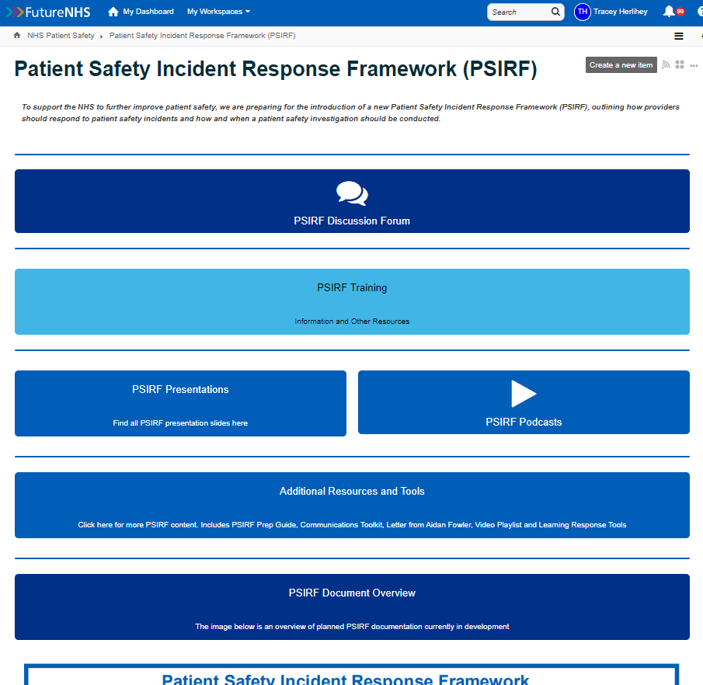
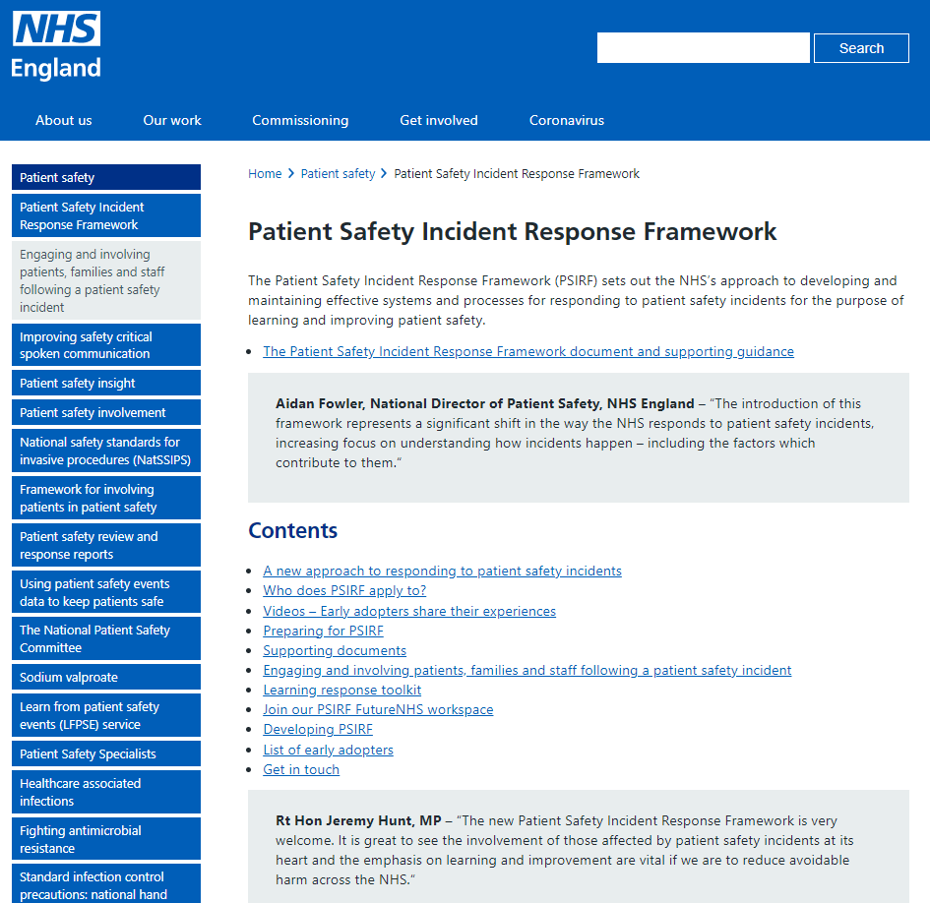
Find out more
Your Trust might have a local site dedicated to PSIRF
The NHS patient safety workspace is open to all to access.
You do not need an NHS email address.
If you are not already a FutureNHS user, you can request access by emailing NHSps-manager@future.nhs.uk

