Slide 1
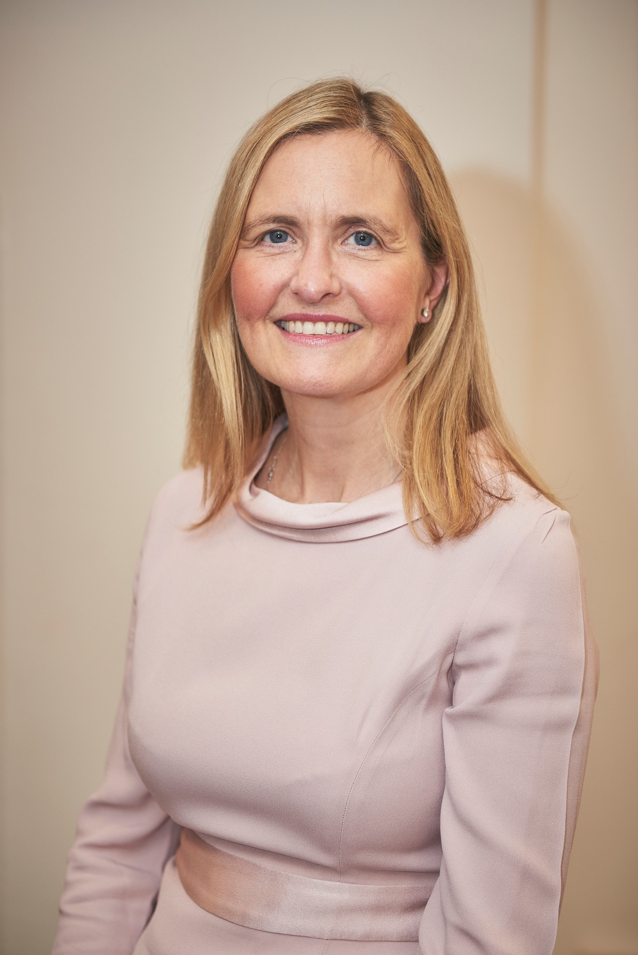
Dr Henrietta Hughes
Patient Safety Commissioner
Making patients our purpose
RCP Webinar: Patients and PSRIF
27th June 2023

Slide 2
My role
Appointed by the Secretary of State for Health and accountable to Parliament
To amplify patients’ voice and champion the value of listening to patients
To seek improvements to patient safety around the use of medicines and medical devices

Slide 3
Listening to patients

Slide 4
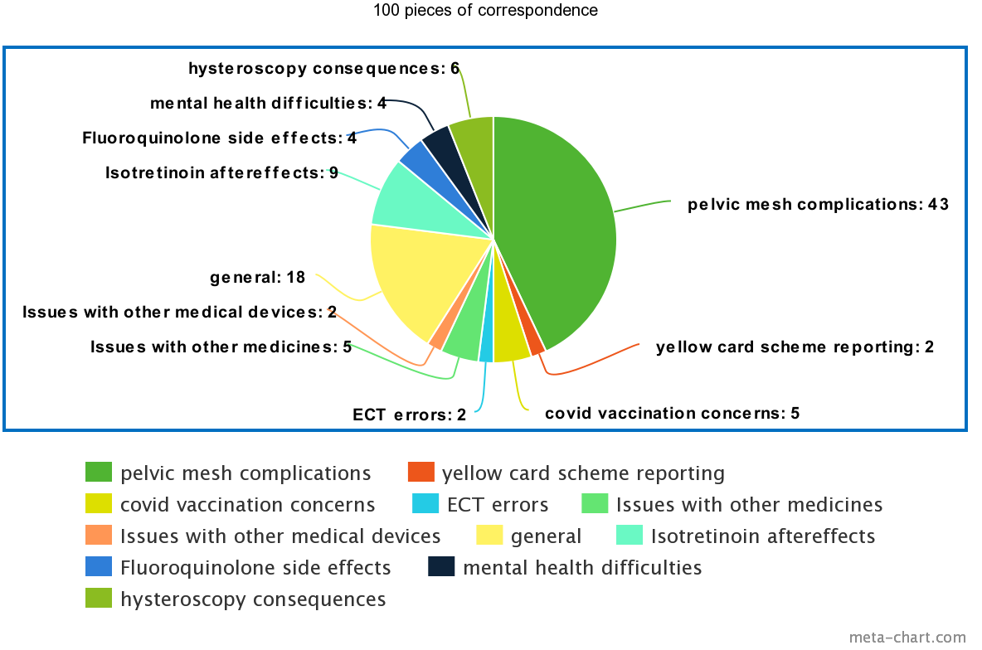
100 voices

Slide 5
Culture change
Speak up, listen up, follow up
Consent
Conflicts of interest
Watch Nadine's story - consent (part two) - NHS Resolution

Slide 6
Benefits of patient participation
Outcomes
Experience
Patient Participation
Efficiency savings
NHS England » Involving people in their own care

Slide 7
Responding to patient feedback
Personal
Compassionate
Timely
Relevant
Used for learning
L
E
A
D
E
R
S
H
I
P
Impersonal
Generic
Timely
No response
Defensive
Irrelevant
Slow
Siloed
Exploring the sociocultural contexts in which healthcare staff respond to and use online patient feedback in practice: In-depth case studies of three NHS Trusts - Lauren Ramsey, Rebecca Lawton, Laura Sheard, Jane O’Hara, 2022 (sagepub.com)

Slide 8
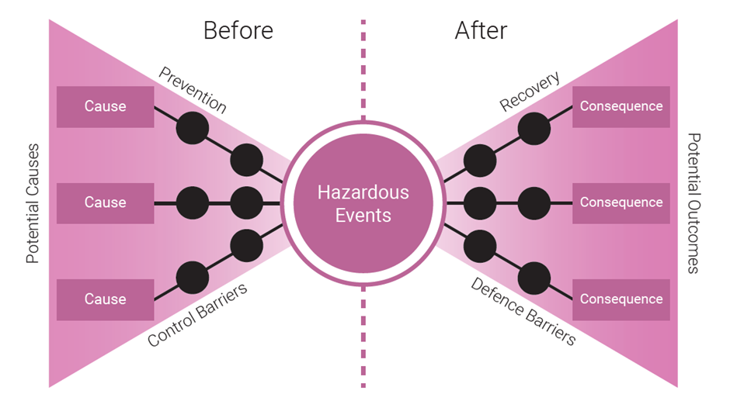
Process safety management

Slide 9
Making it happen
Leadership
Listening
Partnership

Slide 10
Thank you
Website: www.patientsafetycommissioner.org.uk
Email: Commissioner@PatientSafetyCommissioner.org.uk
Twitter: @PSCommissioner

